Slide 1
Understanding the Open Graph Protocol
Introduction
Facebook unveiled something called the Open Graph protocol (OGP) back in April 2010.
OGP is a mechanism that enables developers to make any web page an object in Facebook’s Social Graph by injecting some RDFa metadata into the page.

Slide 2
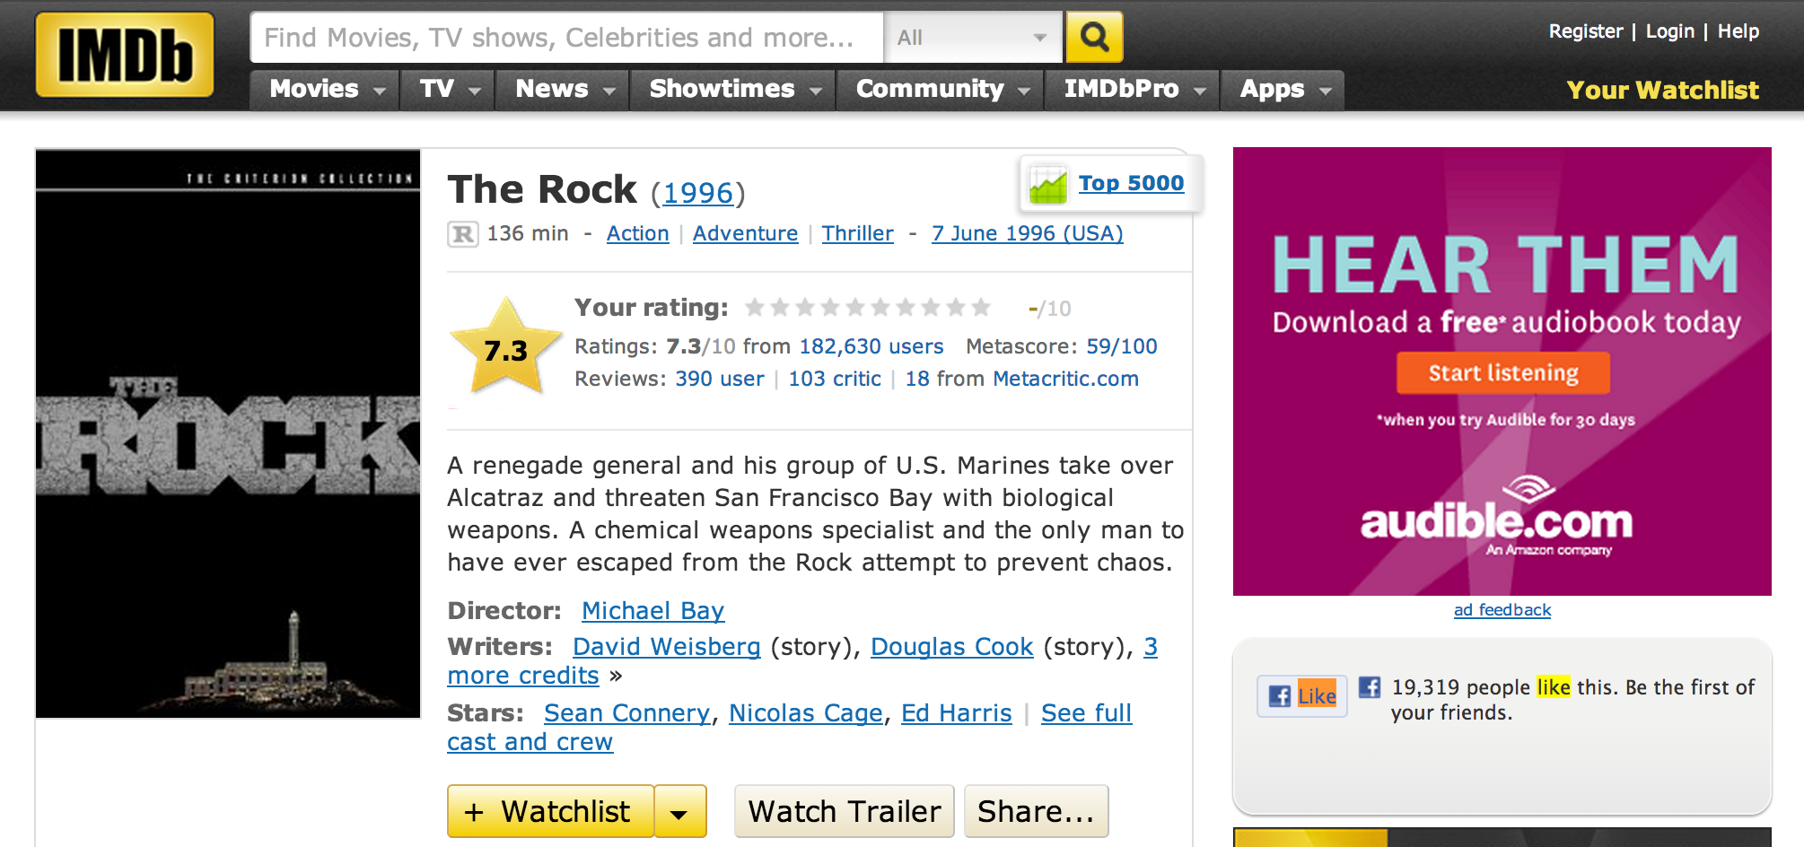
Example
Figure 2-5. An IMDb page featuring an implementation of OGP for The Rock

Slide 3
Implementation of OGP
XHTML document that uses namespaces looks something like this:
<html xmlns:og="http://ogp.me/ns#">
<head>
<title>The Rock (1996)</title>
<meta property="og:title" content="The Rock" />
<meta property="og:type" content="movie" />
<meta property="og:url" content="http://www.imdb.com/title/tt0117500/" />
<meta property="og:image" content="http://ia.media-imdb.com/images/rock.jpg" />
...
</head>
...
</html>

Slide 4
Implementation
At its core, querying the Graph API for Open Graph objects is incredibly simple:
For example, fetching the URL: http://graph.facebook.com/http://www.imdb.com/title/tt0117500 in your web browser would return this response:
{
"id": "114324145263104",
"name": "The Rock (1996)",
"picture": "http://profile.ak.fbcdn.net/hprofile-ak-snc4/hs344.snc4/...jpg",
"link": "http://www.imdb.com/title/tt0117500/",
"category": "Movie",
"description": "Directed by Michael Bay. With Sean Connery, ...",
"likes" : 3
}

Slide 5
Implementation
you explicitly request additional metadata for an object in the page by appending the query string parameter metadata=1 to the request. Here is a sample response for the query:
https://graph.facebook.com/114324145263104?metadata=1

Slide 6
Implementation
metadata": {
"connections": {
"feed": "http://graph.facebook.com/http://www.imdb.com/title/...",
"posts": "http://graph.facebook.com/http://www.imdb.com/title/...",
"tagged": "http://graph.facebook.com/http://www.imdb.com/title/...",
"statuses": "http://graph.facebook.com/http://www.imdb.com/title/...",
"links": "http://graph.facebook.com/http://www.imdb.com/title/...",
"notes": "http://graph.facebook.com/http://www.imdb.com/title/...",
"photos": "http://graph.facebook.com/http://www.imdb.com/title/...",
"albums": "http://graph.facebook.com/http://www.imdb.com/title/...",
"events": "http://graph.facebook.com/http://www.imdb.com/title/...",
"videos": "http://graph.facebook.com/http://www.imdb.com/title/...",
},
The items in metadata.connections are pointers to other nodes in the graph that you can crawl to get to other intriguing bits of data.

Slide 7
Analyzing Social Graph Connections
Introduction
An official Python SDK for the Graph API is a community fork of that repository previously maintained by Facebook and can be installed using:
pip install facebook-sdk.

Slide 8
Implementation Methods
Few key methods from the GraphAPI class that you need to know about in order to use the Graph API to fetch data:
1-get_object(self, id, **args)
Example usage: get_object("me", metadata=1)
2-get_objects(self, id, **args)
Example usage: get_objects(["me", "some_other_id"], metadata=1)
3-get_connections(self, id, connection_name, **args)
Example usage: get_connections("me", "friends", metadata=1)
4-request(self, path, args=None, post_args=None)
Example usage: request("search", {"q" : "social web", "type" : "page"})

Slide 9
Example 2-2. Querying the Graph API with Python
import facebook # pip install facebook-sdk
import json
# A helper function to pretty-print Python objects as JSON
def pp(o):
print json.dumps(o, indent=1)
# Create a connection to the Graph API with your access token
g = facebook.GraphAPI(ACCESS_TOKEN)

Slide 10
Example
# Execute a few sample queries
print '---------------'
print 'Me'
print '---------------'
pp(g.get_object('me'))
print
print '---------------'
print 'My Friends'
print '---------------'
pp(g.get_connections('me', 'friends'))
print
print '---------------'
print 'Social Web'
print '---------------'
pp(g.request("search", {'q' : 'social web', 'type' : 'page'}))
to query for information about you, information about your friends, and the term social web.

Slide 11
Sample Output
---------------
Me
---------------
{
"last_name": "Russell",
"relationship_status": "Married",
"locale": "en_US",
"hometown": {
"id": "104012476300889",
"name": "Princeton, West Virginia"
},
"quotes": "The only easy day was yesterday.",
"favorite_athletes": [
{
"id": "112063562167357",
"name": "Rich Froning Jr. Fan Site"
}
],

Slide 12
Sample Output
---------------
My Friends
---------------
{
"paging": {
"next": "https://graph.facebook.com/644382747/friends?...",
},
"data": [
{
"name": "Bas Russell",
"id": "6224364"
},
...
{
"name": "Jamie Lesnett",
"id": "100002388496252"
}
]
}

Slide 13
Sample Output
---------------
Social Web
---------------
{
"paging": {
"next": "https://graph.facebook.com/search?q=social+web&type=page...",
},
"data": [
{
"category": "Book",
"name": "Mining the Social Web“,
"id": "146803958708175"
},
{
"category": "Internet/software",
"name": "Social & Web Marketing",
"id": "172427156148334"
}

Slide 14
Analyzing Facebook Pages
Introduction
Facebook started out as more of a pure social networking site.
It quickly adapted to take advantage of the market needs.
Fast-forward a few years, and now businesses, clubs, books, and many other kinds of nonperson entities have Facebook pages with a fan base.
Facebook pages are a powerful tool for businesses to engage their customers, and Facebook has gone to some lengths to provide tools that allow Facebook page administrators to understand their fans.

